Slide 1
Evaluating the Robustness of Graph Neural Networks Against Text-Based Adversarial Attacks
Prepared by -
Sriram Hebbale
Avviral Jain
Siddhartha Gotur

Slide 2
Introduction
Challenging the Robustness of Text-Attributed GNNs:
Why Graphs? Graph-structured learning is everywhere today! It's the go-to way to understand relational data in complex systems like:
Citation networks (papers citing each other)
Social media feeds
Recommendation engines
Adding Layers: But real-world nodes come with rich textual content (abstracts, user posts, descriptions).
Graph Neural Networks (GNNs) are great at blending the graph structure with these node features to solve classification and prediction tasks.

Slide 3
Graphs can be attacked in two ways we look at:
Structural Attacks (e.g: changing the edges, etc)
Textual Attacks: (attacking the text in the nodes)
The textual attacks that we pursue were of two types:
Unicode injection
Paraphrasing

Slide 4
Dataset and Preprocessing
Dataset: OGBN-ArXiv (Hu et al., 2020)
Domain: Citation network of Computer Science papers from Microsoft Academic Graph (MAG)
Scale: 169,343 papers (nodes)
Graph Structure: Directed edges represent citation links
Task: Node classification into 40 subject areas
Data Split (official):
Training: 90,941 nodes
Validation: 29,799 nodes
Test: 48,603 nodes

Slide 5
Text Encoding Pipeline
Text Encoding Pipeline and GNN Training
Objective: Generate node features from text and train a Graph Neural Network (GNN)
Approach:
Use pretrained sentence embedding models to encode paper text
Use embeddings as input features for GNN training

Slide 6
Text Encoders Evaluated
all-MiniLM-L6-v2 (384-dim):
Lightweight SBERT model
all-MiniLM-L12-v2 (384-dim):
Larger MiniLM variant
Used for initial screening only
all-mpnet-base-v2 (768-dim):
State-of-the-art SBERT model based on MPNet
paraphrase-multilingual-mpnet-base-v2 (768-dim):
Multilingual MPNet variant
Used for initial screening only
intfloat/e5-base-v2 (768-dim):
State-of-the-art LLM-based embedding model

Slide 7
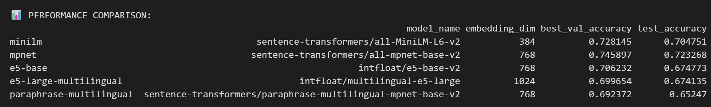
Baseline performances

Slide 8
Experiment 1: Unicode Injection
Attempt 1 : injecting ex : ‘\u0061’ etc at different rates
Changes we tried implementing :
Homoglyph attack
Currency characters
Emoji insertion
Mixed script

Slide 9
Attack application:
Only test set was attacked (48,603 nodes)
Attack rates : 15 %, 25 %, 35 %
Pretrained models are loaded and evaluated on attacked test set

Slide 10
Metrics
Model Robustness Metrics
Clean Accuracy: Performance on unmodified test data
Attacked Accuracy: Performance after adversarial perturbations
Accuracy Drop: Difference between clean and attacked accuracy
Prediction Flip Rate: Fraction of nodes whose prediction flips from correct to incorrect under attack
Embedding Perturbation Analysis
MSE: Mean squared difference between clean and attacked embeddings (Unicode attacks)
L2 Distance: Average Euclidean distance between embedding pairs (Unicode attacks)
Cosine Similarity: Mean, median, and max similarity between clean and attacked embeddings (Unicode )

Slide 11
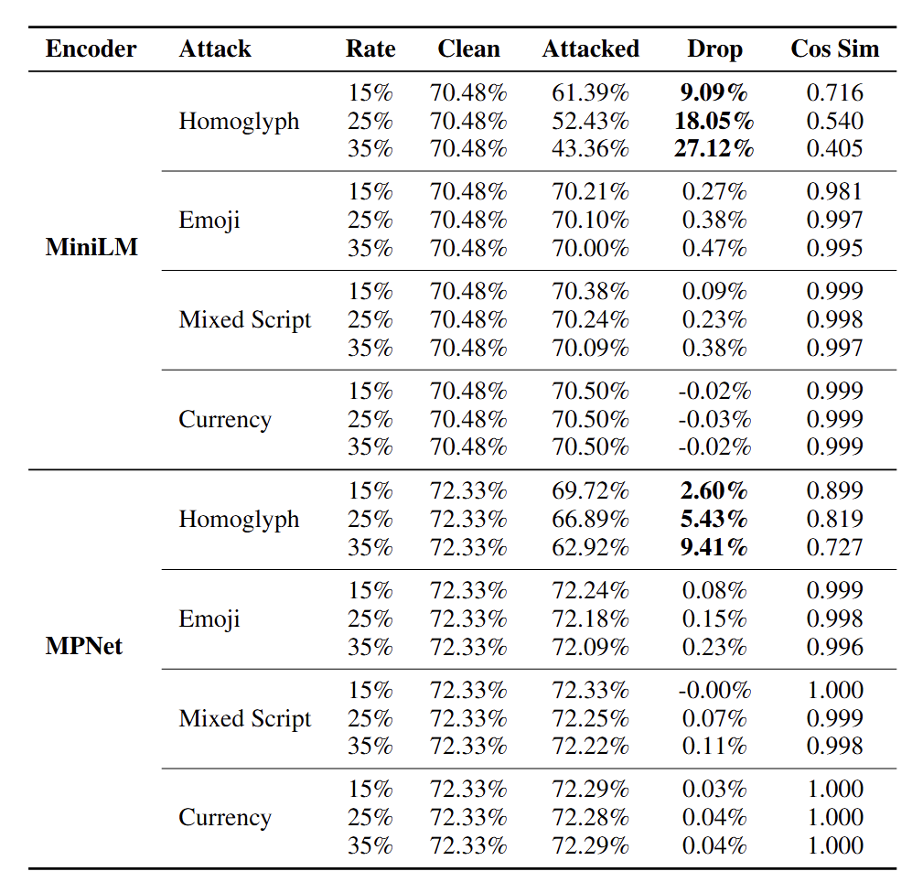
Results:

Slide 12
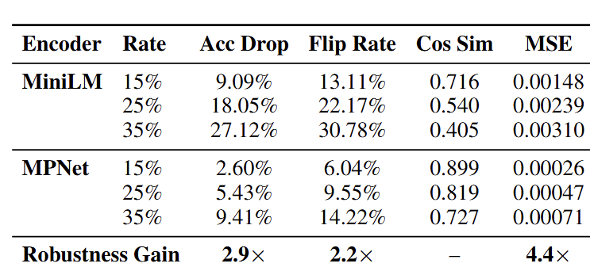
Homoglyph attack analysis

Slide 13
Why homoglyph attacks succeed
Both encoders are predominantly trained on English corpora
Out-of-vocabulary (OOV), forcing fragmentation into unknown character sequences
Mapped to distinct token IDs, producing entirely different embeddings despite visual identity

Slide 14
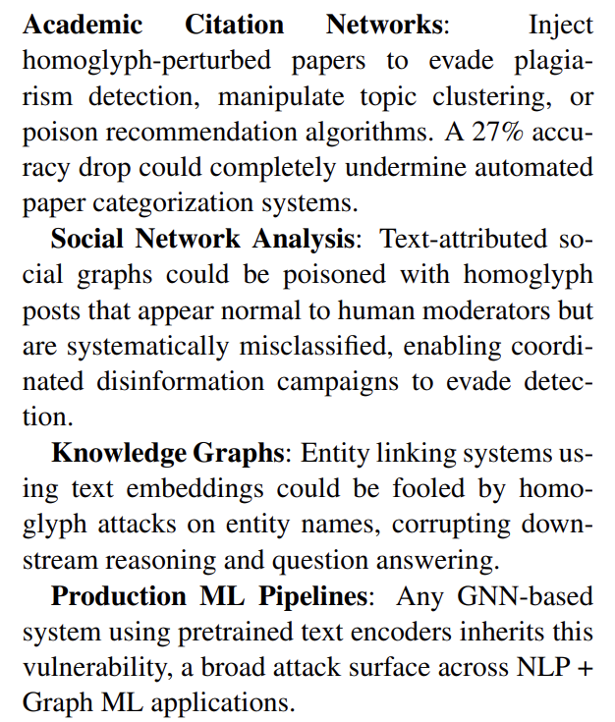
Real world scenarios

Slide 15
Why homoglyph attacks succeed
Both encoders are predominantly trained on English corpora
Out-of-vocabulary (OOV), forcing fragmentation into unknown character sequences
Mapped to distinct token IDs, producing entirely different embeddings despite visual identity

Slide 16
Experiment 2: Paraphrasing Attack
Type 1: Direct Paraphrasing Attack
Test documents are rewritten using a paraphrasing model
Two attack strengths evaluated:
Single-step paraphrasing: Original text paraphrased once
Two-step paraphrasing: Paraphrased output paraphrased again to compound semantic drift
Increases embedding perturbation while maintaining semantic consistency

Slide 17
Type 2: Back-Translation Attack
Text is translated to a pivot language and then translated back to English
Preserves meaning while introducing syntactic and lexical variation
Pivot languages evaluated:
Chinese (zh)
Hindi (hi)
German (de)

Slide 18
Attack Application Protocol
Attacks are applied only to test nodes (48,603); training and validation texts remain clean.
Attack generation is deterministic, using node IDs as random seeds.
After modification, all 169,343 documents are re-encoded with the same sentence encoder.
A hybrid feature matrix is constructed: clean embeddings for train/validation nodes and attacked embeddings for test nodes.
The pre-trained GNN is evaluated directly, with no retraining.

Slide 19
Metrics
Clean Test Accuracy: Baseline performance on the unmodified test set.
Attacked Test Accuracy: Performance after applying adversarial perturbations.
Accuracy Drop (ΔAcc): Absolute difference between clean and attacked accuracy.
Prediction Flip Rate: Percentage of test nodes whose predictions change from correct to incorrect under attack.

Slide 20
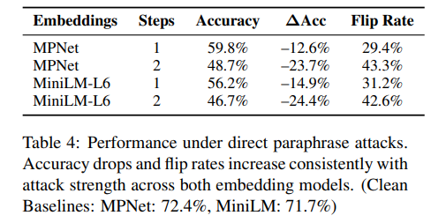
Results

Slide 21
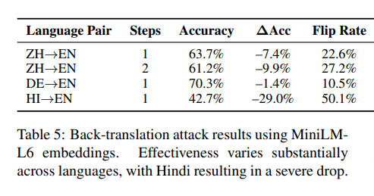
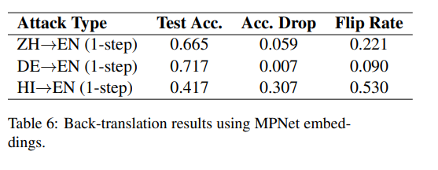
Results

Slide 22
Vulnerability to Semantics-Preserving Attacks
GNNs with text embeddings are highly vulnerable to semantic-preserving paraphrases.
Even single-step paraphrasing causes a substantial number of prediction flips.
Vulnerable to surface-level phrasing, not semantic meaning.
Effect of Attack Strength
Performance degrades consistently from one-step to two-step paraphrasing.
Stronger attacks yield high cosine similarity, yet incorrect predictions.
Reveals a decoupling between semantic similarity and predictive consistency.

Slide 23
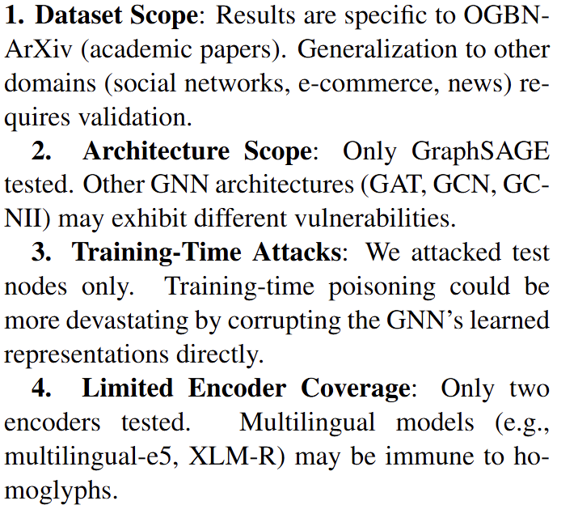
Limitations

